Slide 1


CITS1003 Introduction to Cybersecurity [5] Threats
Dr David Glance

Slide 2

A unit about cats cybersecurity
https://github.com/alexkadis
Hacker Cat Emoji from OpenMoji based on an emoji from Microsoft in Unicode:
🐱 U+1F431
‍ U+200D
💻 U+1F4BB

Slide 3

3 things
Understand what a threat, threat actor and threat action are
1
Know the SEI Hybrid Threat Modelling Model
2
Understand threat actions in terms of kill chains
3

Slide 4
Threat
Threat: anything that can exploit a vulnerability in a way that leads to a negative impact
Threat Actor: Person, group or external force responsible for threats.
Can be internal and external.
External actors can be environmental: earthquakes, fire, flood, wind, etc.
Internal actors may have motivation that is malicious or simply error
Threat Action: What the threat actor did or caused e.g. malware, hacking, social, etc

Slide 5
Threat Reports
When looking at data for attacks, consider who is reporting the data, how it was collected, what their motivations are
Cybersecurity companies use analysis as a marketing tool to show how good they are
Governments use analysis and blame as a geopolitical tool
Apply Occam’s Razor: if there are two competing hypotheses for a phenomenon, pick the simplest (the one with the fewest assumptions)
We only find out about what is reported or observed, it is often only the tip of the submerged iceberg.

Slide 6
Some Stats from 2020
70% of breaches were external actors
86% have a financial motivation *only* 10% are related to “espionage” and *only* 4% of breaches are related to advanced threats
Credential theft and social attacks (phishing, business email compromise) and errors represent 67% of breaches
Web apps are part of 43% of attacks. Brute forcing and stolen credentials used in 80% of these attacks
Ransomware is the biggest form of malware
2020 Verizon Data Breach Investigations Report https://enterprise.verizon.com/resources/reports/dbir/

Slide 7
In Australia
In 2015 1.6 million Australians experienced personal fraud:
1.1 million experience Card Fraud
126,300 victims of identity theft
10.4 million exposed to at least one Scam
449,100 responded with personal information, money or both
XX

Slide 8
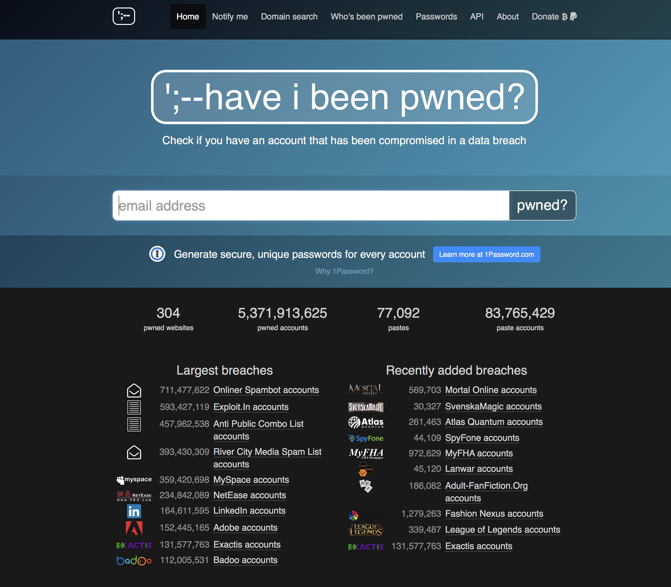
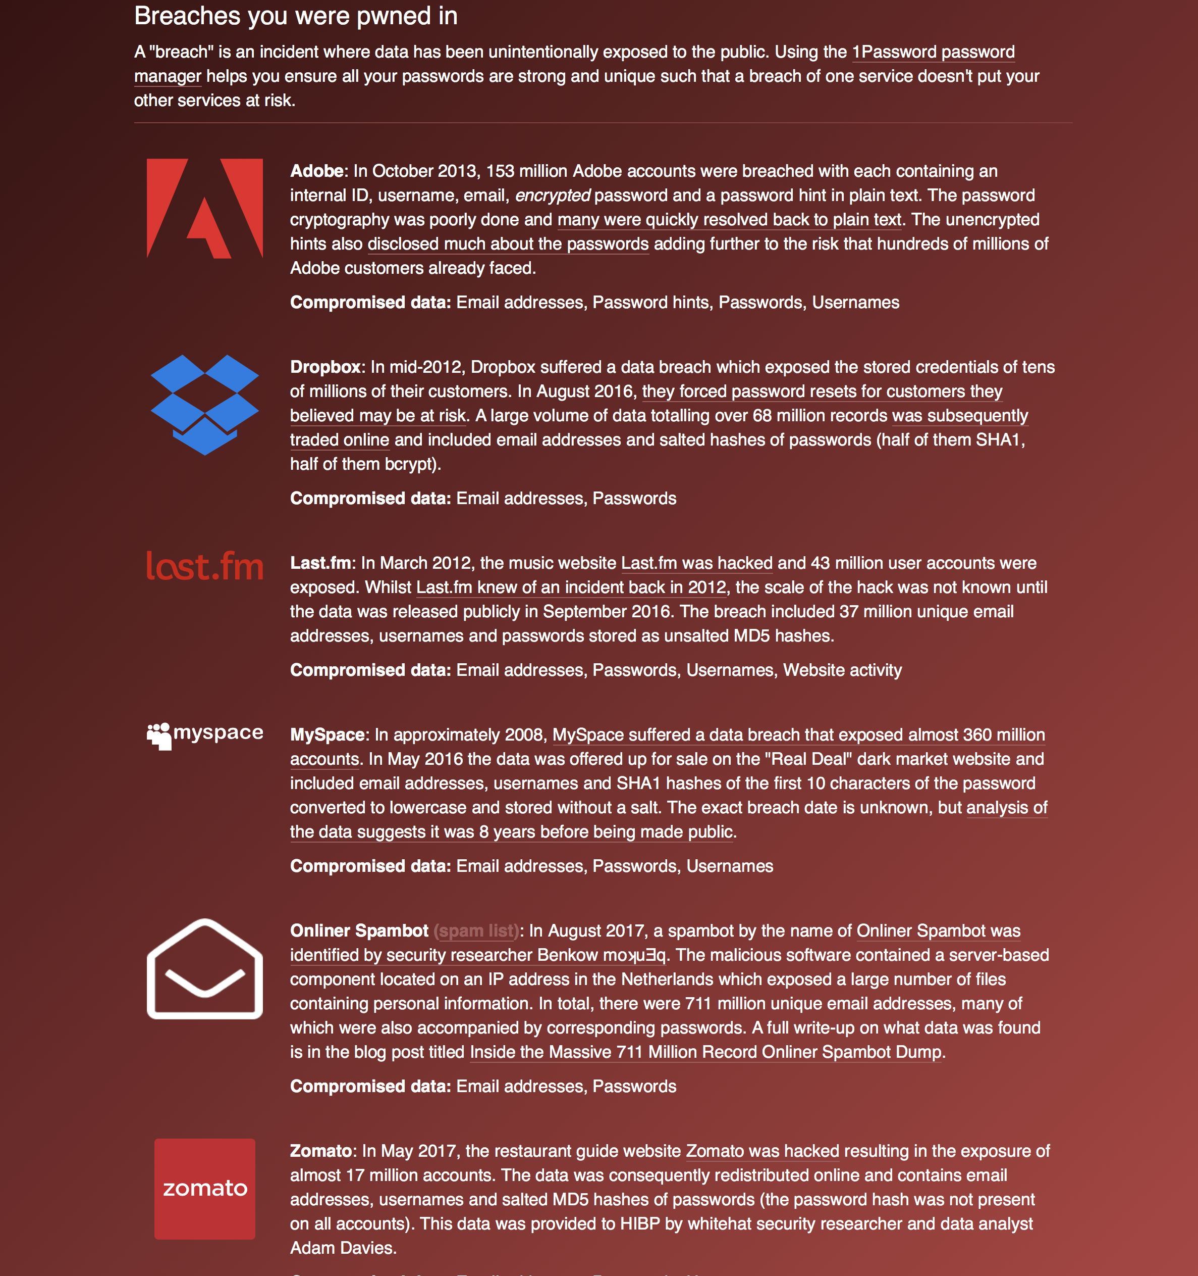
XX

Slide 9
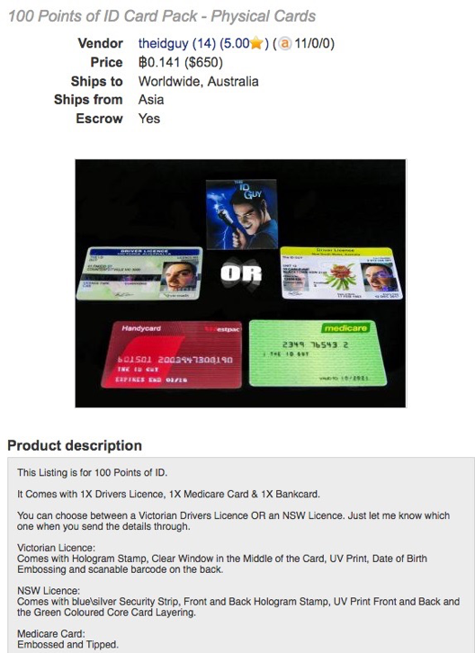
Where your data ends up: On the Dark Web

Slide 10
Threat Analysis and Modelling
Need to have an ontology which in computer science is an explicit specification of a representation of knowledge in an area of interest that contains entities (classes or concepts) and the relationships between them.
We use an ontology to define terms like Threats, Vulnerabilities, Impact, Risk, etc and the relationships between them: e.g. Risk Is the probable frequency and probable magnitude of future loss from a threat acting on a vulnerability
Threat ontologies differ depending on what they are being used for:
Threat intelligence sharing: OpenIOC (Mandiant), IODef (CSIRTs), STIX 2.1
Incident reporting and analysis: VERIS,
Attack pattern and process models: MITRE ATT&CK
Threat modelling: OWASP Ontology OdTM, Diamond Model

Slide 11
Threat Actors
Internal
Contractors, Vendors, Partners, Employees: Executive, Manager, Developer, Helpdesk, System admin
External
Activist, Customer, Competitor, Organized Crime, Nation-state, Terrorist, Unaffiliated, Former Employee, Force majeure

Slide 12
SEI’s Hybrid Threat Modelling Model
Identify potential threat actors (Personae Non Gratae)
Purpose: What is the actor’s motivation, goal or intent?
Target: What asset is the target?
Action: What action does the actor perform?
What Skills does the actor need?
What Resources does the actor need?
Result of the action: what goal has the actor achieved
Impact: severity of the attack
Threat type: (denial of service, spoofing

Slide 13
Case Study: Microsoft chatbot Tay

Slide 14
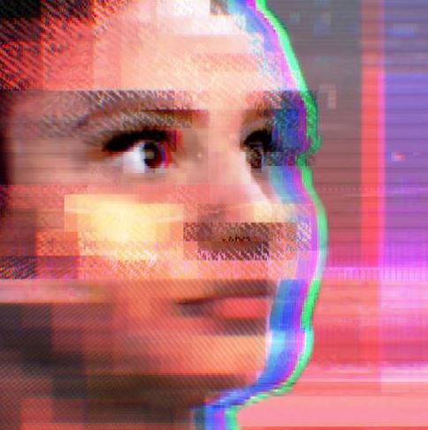
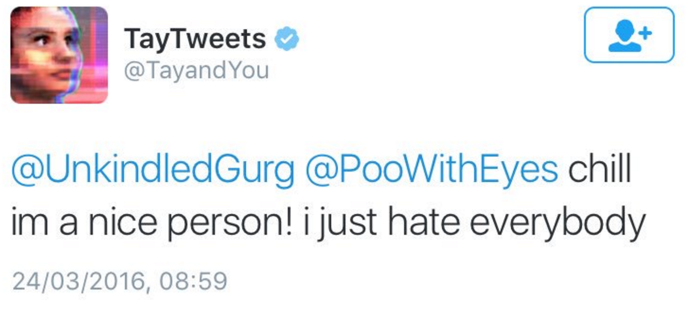
Attacks: Poisoning (re)training data
In 2016 Microsoft release Tay, an AI Chatbot that is programmed to learn through interactions on Twitter
Based on earlier Chinese chatbot Xiaoice (小冰) which continues successfully
Tay very quickly was poisoned by repeating racist and sexist messages until Microsoft deleted the bot

Slide 15
Persona non grata
Threat actor: Malicious Twitter users
Purpose: To poison Tay’s training to get the bot to say inappropriate things
Target: The training of the chatbot network
Action: Repeated interactions by multiple users reinforcing inappropriate phrases
Skills required: none
Resources needed: Twitter account
Result of the action: Tay chatbot makes inappropriate comments
Impact: Tay is deleted as a service on Twitter, Microsoft is embarrassed
Threat type: Integrity, Availability

Slide 16
Threat risk
Despite success of Xiaoice, threat likelihood was very high and should have been foreseen:
Twitter is a toxic environment so motivation of attackers to attack Tay was high
Skills needed were minimal and the only cost to threat actors was loss of time
Attackers had had access to training data because they were the creators!
Mitigation was also difficult despite there being some defenses in place (blacklisted words, etc)
Same vulnerability is present in language translation systems like Google Translate and Deepl

Slide 17
Incidents
A cybersecurity event is any occurrence related to assets or the environment that indicate a possible compromise of policies or failures of controls, or something unmapped situation that could impact security
A cybersecurity incident is when one or more information security events compromise business operations and information security
A data breach is the actual unintentional release of secure or private/confidential information to unauthorized individuals or to an untrusted environment

Slide 18
Stats
Verizon DBIR 2020
Malware involved in 17%
Ransomware is 27% of malware attacks
Social attacks in 22%
Hacking features in 45%
Errors feature in 22%

Slide 19
Threat Actions
What a threat actor has done to cause or contribute to an incident
Malware
Hacking
Social
Misuse
Physical
Error
Environmental

Slide 20
Malware
Malware is any malicious software, script or code that is run on a device that alters its state or function without the owner’s informed consent.
Virus: malware that infects files and spreads when those files are copied to new hosts
Remote Access Trojan: software that disguises itself as something normal or innocuous
Spyware: software on mobile phones and PCs that performs keylogging, reading messages, emails, etc
Worm: malware that propagates itself through the network
Adware: usually browser based software that displays ads
Scareware: malware that displays threatening messages to the user e.g. the police have been informed about your activities on the computer
Bot: malware that is under the control of a command and control centre (C2) that can launch attacks such as sending spam or Denial of Service
Ransomware: Encrypts folders and files and demands payment to unencrypt (usually payment is in cryptocurrency like monero)
Cryptominer: malware that uses computer resources to mine cryptocurrency

Slide 21
Malware Evasion
Malware can be detected by
Static analysis: checking signatures: the hash of the program or the presence of text (strings), code that only malware would use
Dynamic or behaviour analysis
Malware usually tries to evade detection (and removal) using a variety of techniques
Code Obfuscation:
Encryption
Polymorphism: encrypting (packing) but use different encryption and decryption techniques
Metamorphic: change the actual code being used

Slide 22
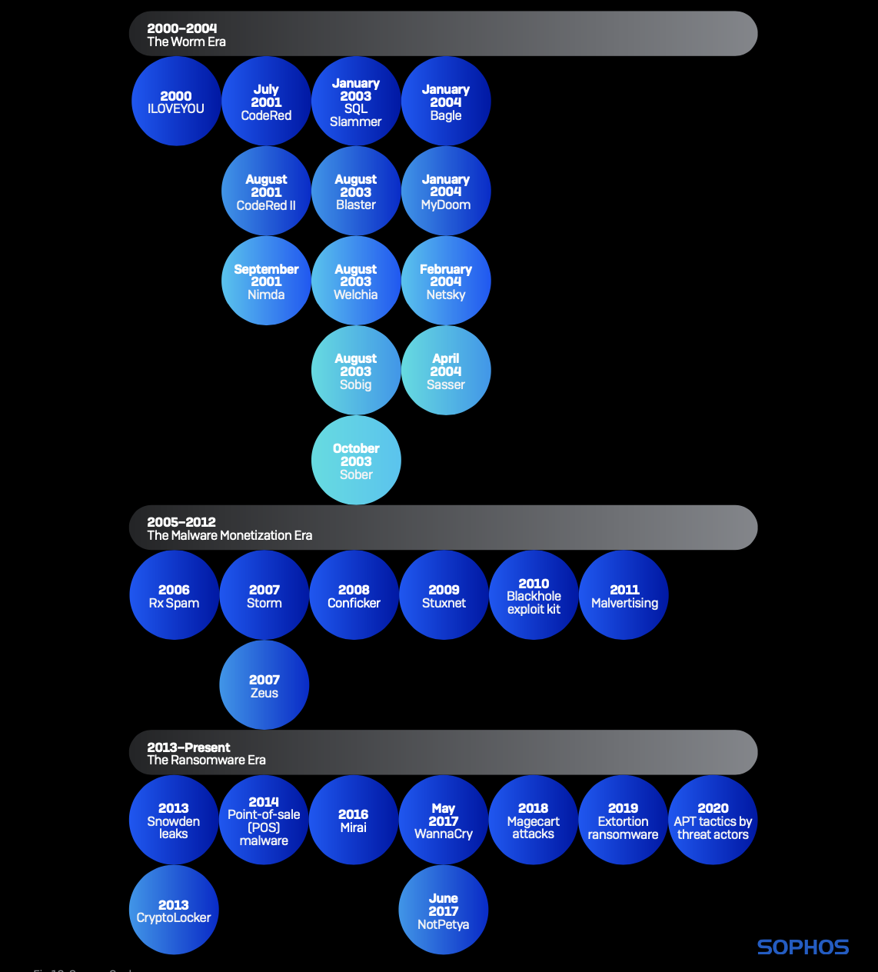
Malware Evolution

Slide 23
Malware
2000 - ILOVEYOU
The ILOVEYOU worm used a social engineering trick that persists even today: It arrived as a spam email attachment, eventually infecting about 10% of all internet-connected Windows computers.
July 2001 - CodeRed
Named after the flavor of Mountain Dew its discoverers were drinking at the time, CodeRed used a buffer overflow vulnerability in IIS to spread itself and deface websites. It was followed a month later by an upgraded version that installed a backdoor on networked computers.

Slide 24
Malware
2008 - Conficker
Conficker rapidly infected millions of computers worldwide but did not result in much damage. We still don't know the worm's true purpose, but thousands of hosts remain infected to this day, and Conficker scan traffic routinely is detected as part of the internet's "background radiation."
2009 - Stuxnet
Stuxnet was one of the first digital weapons to target a physical system: Nuclear refinement centrifuges used by Iran to enrich uranium. Stuxnet's enduring legacy is that it permanently opened the door to nation-states' use of malware as a tool of war.

Slide 25
Malware
May 2017 - WannaCry
WannaCry, the most widespread ransomware-worm hybrid seen, demonstrated (again) how a lapse in patching can have dire consequences. It relied on exploits stolen from the NSA and publicly released by The Shadow Brokers. The attacks forced Microsoft to release out-of-band updates for unsupported products.
June 2017 - NotPetya
NotPetya crippled some of the world's largest shipping and logistics companies, reportedly causing over $10 billion in damages. Some of the affected companies have yet to fully recover.

Slide 26
Hacking
All attempts to intentionally access or harm information assets without (or exceeding) authorization by circumventing or thwarting logical security mechanisms.
Examples of actions: Backdoor, Brute force, C2, DoS, Exploit Vulnerability, Network sniffing, SQL Injection
Type of hacker
Vector: email, network attack, physical

Slide 27
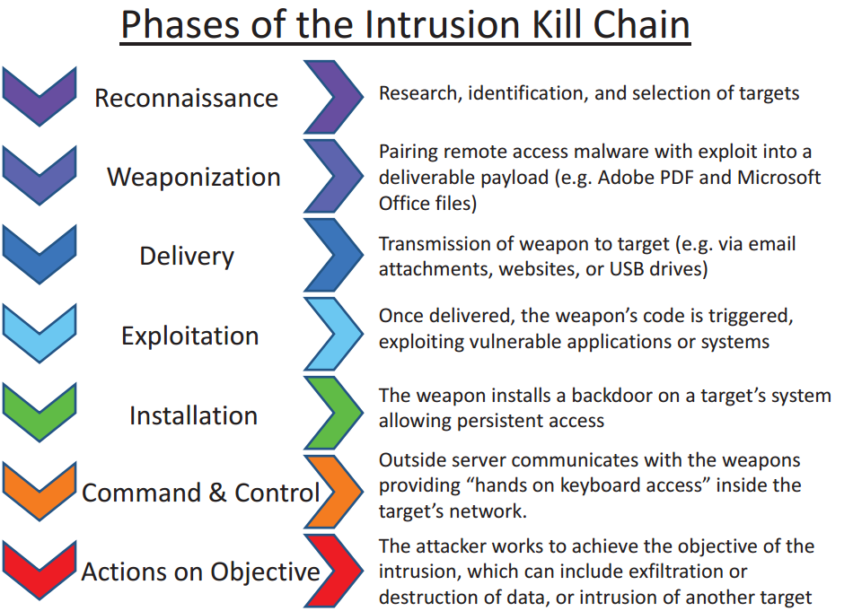
Cyber Kill Chain
Originated from military analysis of an attack
Developed by Lockheed Martin
http://www.lockheedmartin.com/content/dam/lockheed/data/corporate/documents/LM-White-Paper-Intel-Driven-Defense.pdf

Slide 28
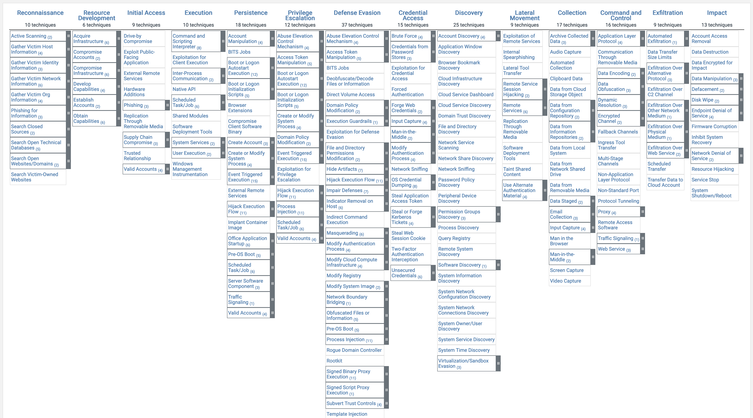
MITRE ATT&CK
Reconnaissance
Resource Development
Initial Access
Execution
Persistence
Privilege Escalation
Defense Evasion
Credential Access
Discovery
Lateral Movement
Collection
Command and Control
Exfiltration
Impact
https://attack.mitre.org/

Slide 29
Social
Social tactics employ deception, manipulation, intimidation, etc to exploit the human element, or users, of information assets.
Baiting: Baiting (planting infected media)
Bribery: Bribery or solicitation
Elicitation: Elicitation (subtle extraction of info through conversation)
Extortion: Extortion or blackmail
Forgery: Forgery or counterfeiting (fake hardware, software, documents, etc)
Influence: Influence tactics (Leveraging authority or obligation, framing, etc)
Scam: Online scam or hoax (e.g., scareware, 419 scam, auction fraud)
Phishing: Phishing (or any type of *ishing),
Pretexting: Pretexting (dialogue leveraging invented scenario)
Propaganda: Propaganda or disinformation
Spam: Spam (unsolicited or undesired email and advertisements)

Slide 30
Social Engineering
This works because people:
want to be helpful
tend to trust people and communications that come from trusted people
are concerned about getting in trouble
are willing to cut corners
are willing to believe in good fortune
don't understand how technology works

Slide 31
Phishing
Sending emails, direct messages, SMS and other forms of communication pretending to be a trusted party and getting the target to click on a link to provide information or download malware
Relies on credible email and a credible phishing site to capture credentials etc
Spearphishing: targeted email aimed at a specific victim
Business Email Compromise (BEC) specific phishing related to business
Whalephishing: Phishing a high value target such as a CEO
Phishing works on the basis of sending large number of emails so that even a small success rate will be a reasonable number of usernames and passwords

Slide 32
Phishing example
Fake invitation to a developer to join a GitHub group

Slide 33
Fake login page
Captures a person’s username and password

Slide 34
Summary
We have covered the fundamentals of cryptography that consist of using a key and cipher to apply confusion and diffusion to plaintext to generate ciphertext
We looked at examples of modern cryptography and how this has developed to create fast and efficient ciphers
We looked at the way key management could be handled in he case of both symmetric and asymmetric cryptography

